Slide 1
HungerMate
Feature 2
Christopher Mendoza
Gabriel Braun
Haricharan Mukthineni

Slide 2
Introduction
HungerMate is a C++ application which lets users order food from multiple restaurants.
Project Feature 2 includes updates to the restaurant database and allowing users to choose restaurants and menu items

Slide 3
Background from Feature 1
Created a main menu that lets the user input whether they are ready to order or to exit the application
Then, if the user is ready to order, they are taken to a submenu that displays all of the restaurants
Users may filter the restaurants by cuisine, and when they do this the application will retrieve the restaurant names that serve food according to the cuisine desired

Slide 4
Feature 2 Overview:
Feature 2 of the HungerMate application allows users to select a restaurant, view the restaurant’s menu, and select items from the menu to add to their cart
Users are also able to customize their orders by writing in a textbox after they have finished assembling their order
Additional entries have been made to the restaurant and menu tables in the database

Slide 5
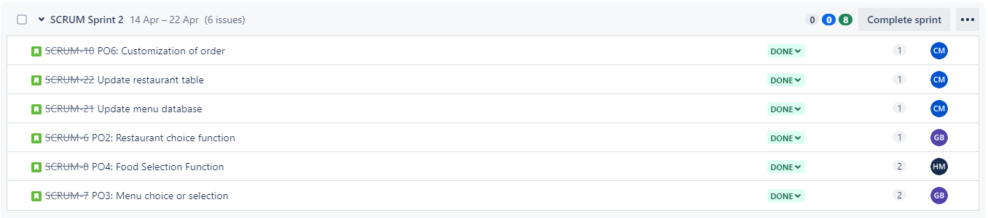
Sprint for Feature 2

Slide 6
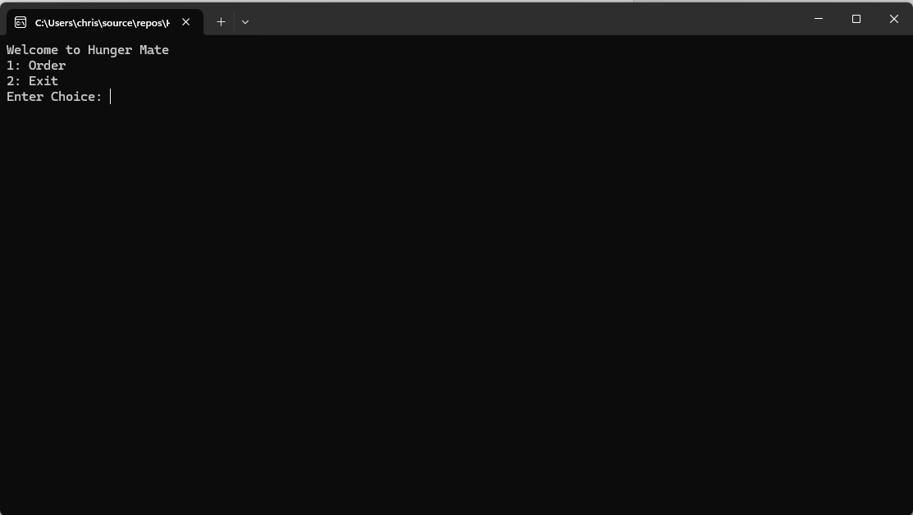
Hunger Mate Main Menu

Slide 7
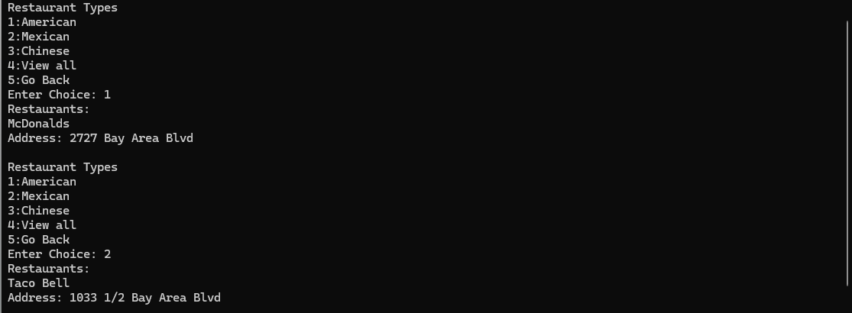
Hunger Mate Filter Menu

Slide 8
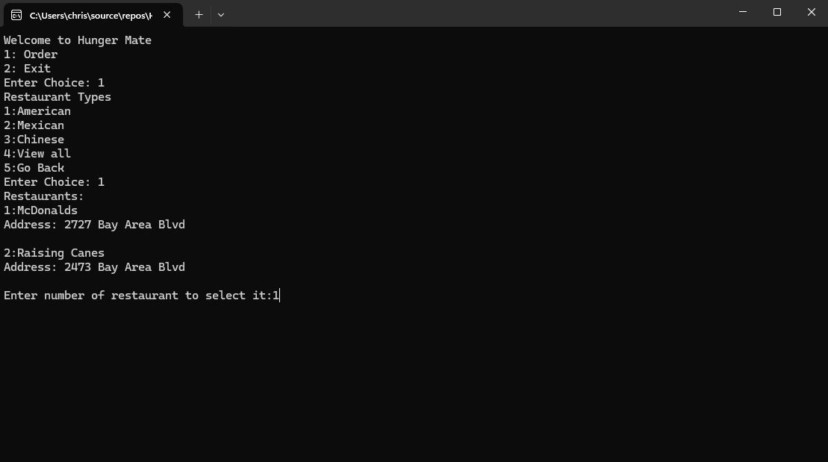
Hunger Mate Restaurant Options Display

Slide 9
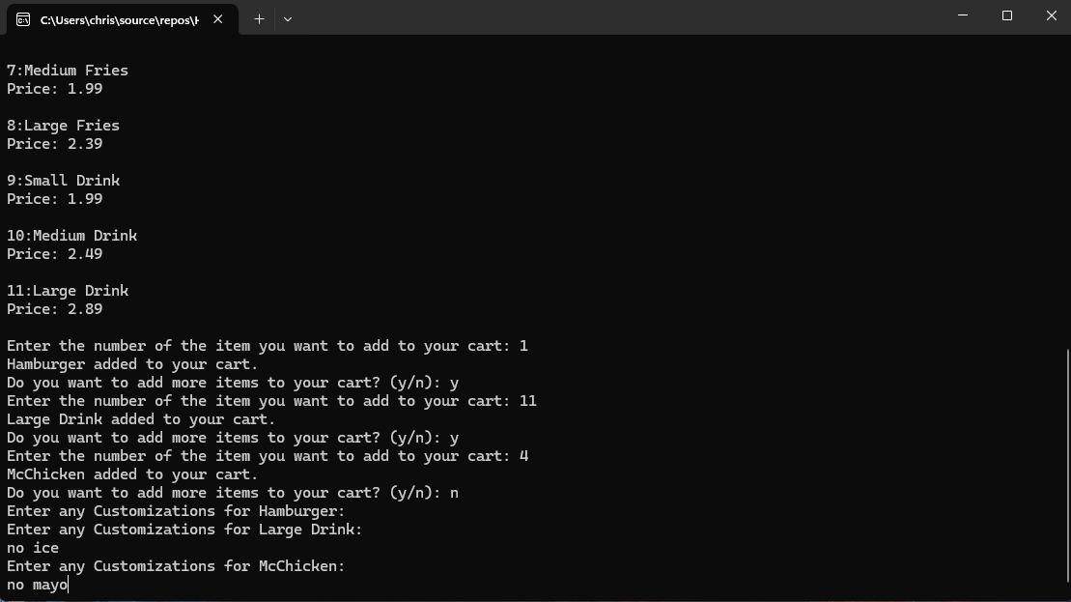
Item Selections and Customizations

Slide 10
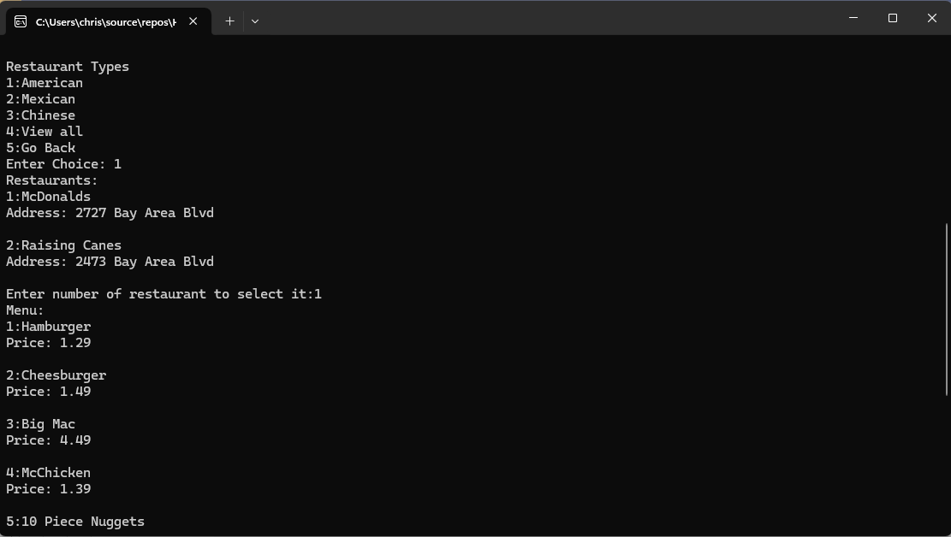
Hunger Mate Restaurant Menu Options Display

Slide 11
THANKYOU

